Slide 1
Bragg Equation
n λ= 2 d sinΘ
n must be an integer and is assumed to be one unless otherwise stated.
Below is a sketch of the apparatus which we will not go into.
Detector typically moves over range of 2 Θ angles
X-ray detector
2Θ
2Θ
X-ray source
Typically a Cu or Mo target
1.54 or 0.8 Å wavelength
Sample holder
Orientation of diffracting planes

Slide 2
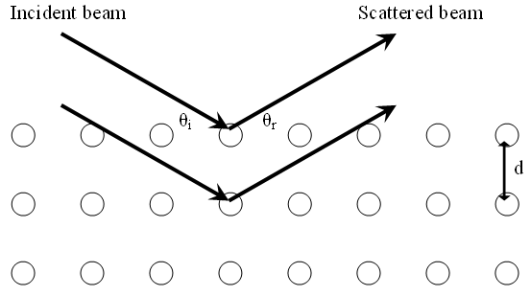
Bragg’s Equation
n λ= 2 d sinΘ
Below are the layers of atoms in a crystal. The arrows represent light that is bouncing off of them. The light has a known wavelength or λ . d is the distance between the layers of atoms. Θ is the angle that the light hits the layers.

Slide 3
Bragg Equation Example
n λ= 2 d sinΘ
If the wavelength striking a crystal at a 38.3° angle has a wavelength of 1.54 Ǻ, what is the distance between the two layers. Recall we assume n = 1. You will need your calculator to determine the sine of the angle.
1.54 Ǻ = 2 d sin 38.3°
this can be rearranged to d = λ / (2 Sin θ_{B})
SO
= 1.54 Ǻ / ( 2 * Sin 38.3 ) → = 1.24 Ǻ

Slide 4
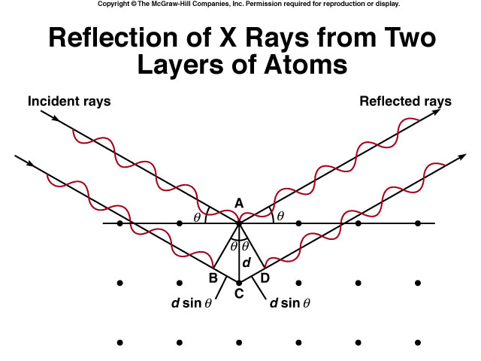
Extra distance =
BC + CD =
2d sinθ
= nλ
(Bragg Equation)

Slide 5
X rays of wavelength 0.154 nm are diffracted from a crystal at an angle of 14.17⁰. Assuming that n = 1, what is the distance (in pm) between layers in the crystal?
n λ = 2 d sin θ
The given information is
n = 1
θ = 14.17⁰
λ = 0.154 nm = 154 pm
n λ
1 x 154 pm
d =
=
= 314.54 pm
2 sinθ
2 x sin14.17

Slide 6
It’s Importance
The Bragg equation enables us to find the dimensions of a unit cell. This gives us accurate values for the volume of the cell.
As you will see in the following on unit cells and the equations, this is how density is determined accurately.

Slide 7
Spectroscopic Techniques
Utilize the absorption or transmittance of electromagnetic radiation (light is part of this, as is UV, IR) for analysis
Governed by Beer’s Law
  A=abc
  Where: A=Absorbance, a=wavelength-dependent absorbtivity coefficient, b=path length, c=analyte concentration

Slide 8
Spectroscopy
Exactly how light is absorbed and reflected, transmitted, or refracted changes the info and is determined by different techniques
sample
Transmittance
spectroscopy
Reflected
spectroscopy
Raman
Spectroscopy

Slide 9
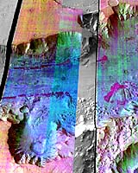
Light Source
Light shining on a sample can come from different places (in lab from a light, on a plane from a laser array, or from earth shining on Mars with a big laser)
Can ‘tune’ these to any
wavelength or range of
wavelengths
IR image of Mars
Olivine is purple

Slide 10
Unit Cells
While there are several types of unit cells, we are going to be primarily interested in 3 specific types.
Cubic
Body-centered cubic
Face-centered cubic

Slide 11
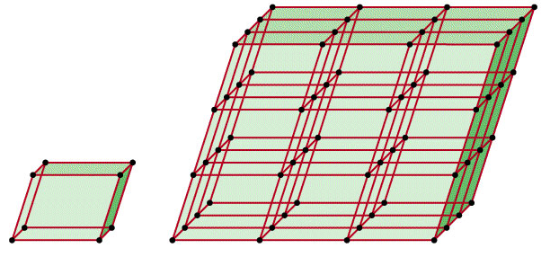
A crystalline solid possesses rigid and long-range order. In a crystalline solid, atoms, molecules or ions occupy specific (predictable) positions.
An amorphous solid does not possess a well-defined arrangement and long-range molecular order.
A unit cell is the basic repeating structural unit of a crystalline solid.
lattice
point
At lattice points:
Atoms
Molecules
Ions
Unit Cell
Unit cells in 3 dimensions

Slide 12
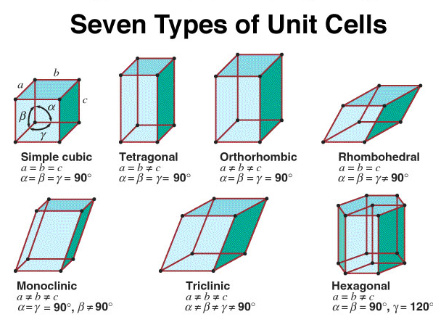

Slide 13
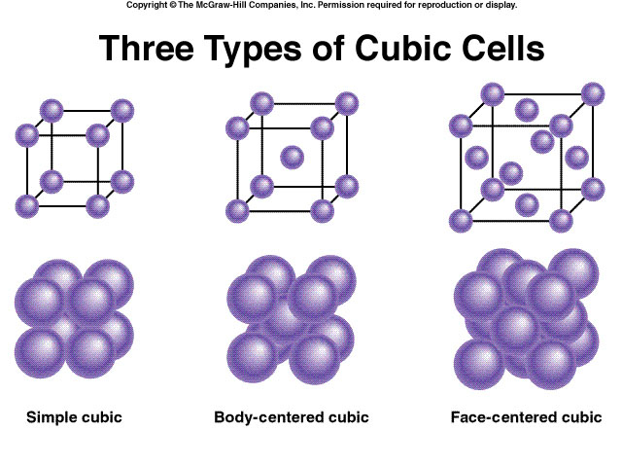

Slide 14
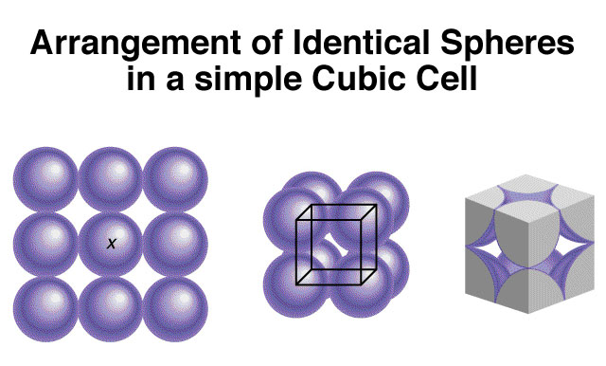

Slide 15
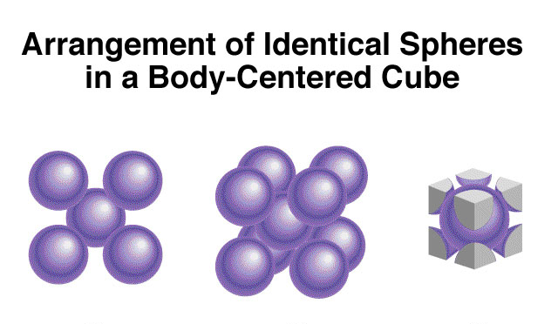

Slide 16
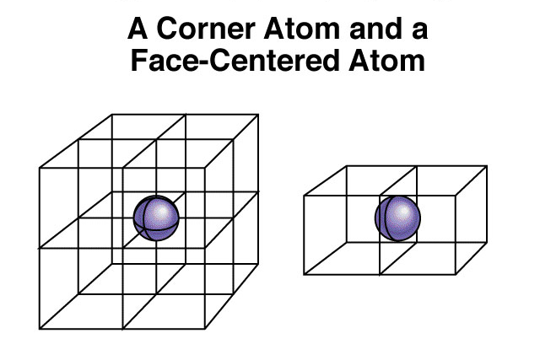
Shared by 8 unit cells
Shared by 2 unit cells

Slide 17
1 atom/unit cell
2 atoms/unit cell
4 atoms/unit cell
(8 x 1/8 = 1)
(8 x 1/8 + 1 = 2)
(8 x 1/8 + 6 x 1/2 = 4)

Slide 18
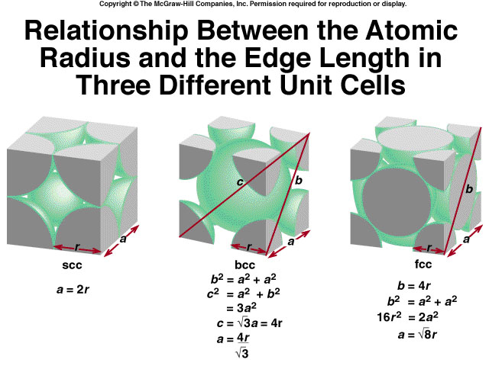

Slide 19
When silver crystallizes, it forms face-centered cubic cells. The unit cell edge length is 408.7 pm. Calculate the density of silver. Though not shown here, the edge length was determined by the Bragg Equation.
m
d =
V = a³
= (408.7 pm)³ = 6.83 x 10⁻²³ cm³
V
Remember that there are 4 atoms/unit cell in a face-centered cubic cell
107.9 g
1 mole Ag
m = 4 Ag atoms
x
x
= 7.17 x 10⁻²² g
mole Ag
6.022 x 10²³ atoms
m
7.17 x 10⁻²² g
d =
=
= 10.5 g/cm³
V
6.83 x 10⁻²³ cm³
This is a pretty standard type of problem to determine density from edge length.

Slide 20
A crystalline solid possesses rigid and long-range order. In a crystalline solid, atoms, molecules or ions occupy specific (predictable) positions.
An amorphous solid does not possess a well-defined arrangement and long-range molecular order.
A unit cell is the basic repeating structural unit of a crystalline solid.
lattice
point
At lattice points:
Atoms
Molecules
Ions
Unit Cell
Unit cells in 3 dimensions

Slide 21
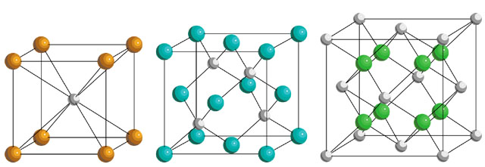
Types of Solids
Ionic Crystals or Solids
Lattice points occupied by cations and anions
Held together by electrostatic attraction
Hard, brittle, high melting point
Poor conductor of heat and electricity
CsCl
ZnS
CaF₂

Slide 22
Types of Solids
Molecular Crystals or Solids
Lattice points occupied by molecules
Held together by intermolecular forces
Soft, low melting point
Poor conductor of heat and electricity

Slide 23
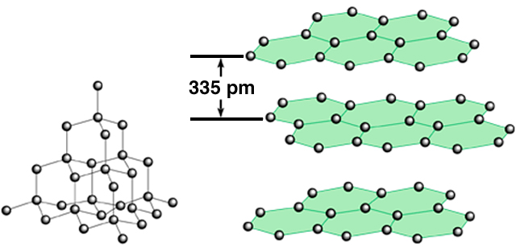
Types of Solids
Network or covalent Crystals or Solids
Lattice points occupied by atoms
Held together by covalent bonds
Hard, high melting point
Poor conductor of heat and electricity
carbon
atoms
diamond
graphite

Slide 24
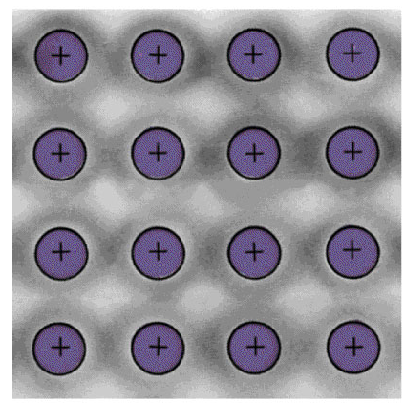
Types of Solids
Metallic Crystals or Solids
Lattice points occupied by metal atoms
Held together by metallic bond
Soft to hard, low to high melting point
Good conductor of heat and electricity
Cross Section of a Metallic Crystal
nucleus &
inner shell e⁻
mobile “sea”
of e⁻

Slide 25
Types of Crystals
Types of Crystals and General Properties

Slide 26
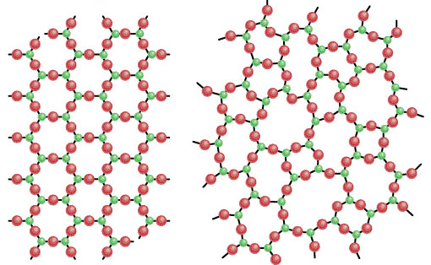
An amorphous solid does not possess a well-defined arrangement and long-range molecular order.
A glass is an optically transparent fusion product of inorganic materials that has cooled to a rigid state without crystallizing
Crystalline
quartz (SiO₂)
Non-crystalline
quartz glass

Slide 27
The Men Behind the Equation
Rudolph Clausius
  German physicist and mathematician
  One of the foremost contributors to the science of thermodynamics
  Introduced the idea of entropy
  Significantly impacted the fields of kinetic theory of gases and electricity
Benoit Paul Émile Clapeyron
  French physicist and engineer
  Considered a founder of thermodynamics
  Contributed to the study of perfect gases and the equilibrium of homogenous solids

Slide 28
The Clausius- Clapeyron Equation
In its most useful form for our purposes:
  In which:
    P₁ and P₂ are the vapor pressures at T₁ and T₂ respectively
    T is given in units Kelvin
    ln is the natural log
    R is the gas constant (8.314 J/K mol)
    ∆H_{vap} is the molar heat of vaporization

Slide 29
Useful Information
The Clausius-Clapeyron models the change in vapor pressure as a function of time
The equation can be used to model any phase transition (liquid-gas, gas-solid, solid-liquid)
Another useful form of the Clausius-Clapeyron equation is:
But the first form of this equation is the
most important for us by far.

Slide 30
Useful Information
We can see from this form that the Clausius-Clapeyron equation depicts a line
Can be written as:
which clearly resembles the model y=mx+b, with ln P representing y, C representing b, 1/T acting as x, and -∆H_{vap}/R serving as m. Therefore, the Clausius-Clapeyron models a linear equation when the natural log of the vapor pressure is plotted against 1/T, where -∆Hvap/R is the slope of the line and C is the y-intercept

Slide 31
Useful Information
We can easily manipulate this equation to arrive at the more familiar form of the equation. We write this equation for two different temperatures:
Subtracting these two equations, we find:

Slide 32
Common Applications
Calculate the vapor pressure of a liquid at any temperature (with known vapor pressure at a given temperature and known heat of vaporization)
Calculate the heat of a phase change
Calculate the boiling point of a liquid at a nonstandard pressure
Reconstruct a phase diagram
Determine if a phase change will occur under certain circumstances

Slide 33
Shortcomings
The Clausius-Clapeyron can only give estimations
  We assume changes in the heat of vaporization due to temperature are negligible and therefore treat the heat of vaporization as constant
  In reality, the heat of vaporization does indeed vary slightly with temperature

Slide 34
Real World Applications
Chemical engineering
  Determining the vapor pressure of a substance
Meteorology
  Estimate the effect of temperature on vapor pressure
  Important because water vapor is a greenhouse gas

Slide 35
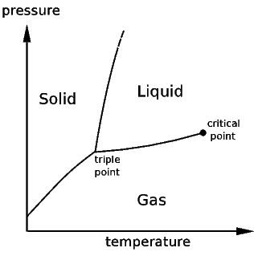
An example of a phase diagram

