Slide 1
Photoelectron Spectroscopy

Slide 2
An Introduction
Photoelectron Spectroscopy is a technique that allows scientists to determine the electronic configurations of atoms and molecules.
Recall from the earlier chapters the Photoelectric Effect ( Albert Einstein ), who determined that when light of a certain wavelength hits a metal, electrons are removed.

Slide 3
Introduction
This energy needed to remove the electron is the Binding Energy.
The Binding Energy is going to be higher for core electrons, which should make sense since they are harder to remove.
UPS uses UV light and is god for valence electrons.
XPS uses X-rays and is good for core electrons.

Slide 4
The Central Theory
The Energy added to the species must be conserved with the energy coming out. So we get this formula: E_{photon} = BE + KE_{electron}
The released energy can be analyzed and a spectra produced.
The spectra is the key to PES

Slide 5
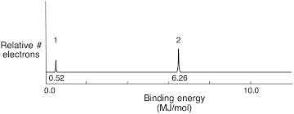
Let’s Take a Look
Look at the PES spectra below.
You notice two peaks: This tells us that there are two different types of orbitals that each have their own Binding Energy.
The higher the Binding Energy, the more it is a core electron.
The higher the peaks, the more electrons there are in that shell. So we want to look at the relative heights from one peak to the other.

Slide 6
Let’s Take a Look
We can determine that the peak at 6.26 must be a core orbital due to it having a higher Binding Energy.
We can also determine that since it is twice as high, it must have twice the number of electrons in it.

