Slide 1
Development
of the
Periodic Table

Slide 2
Forerunners of the Periodic Table
1700’s: 30 elements were known including Cu ,Ag, Au, H, O, N, and C.
1800’s: more elements were beginning to be found by the spectroscopy technique.

Slide 3
Forerunners of the Periodic Table
J.W. Doberiner came up with the technique of triads which classified elements with similar characteristics into groups of threes
For example: Lithium, Sodium, Potassium
The properties of the middle elements are normally the averages of the other two

Slide 4
Forerunners of the Periodic Table
J.A.R. Newlands came up with the idea of placing elements into octaves which repeated properties every eighth element when in order by increasing atomic mass.

Slide 5
Forerunners of the Periodic Table
Dmitri Mendeleev is credited for the modern model of the periodic table which places elements in order by increasing atomic mass and those in the same column had similar properties. All of which helped him down the line when he needed to name the missing element Ekasilicon which was later found in Germany.

Slide 6
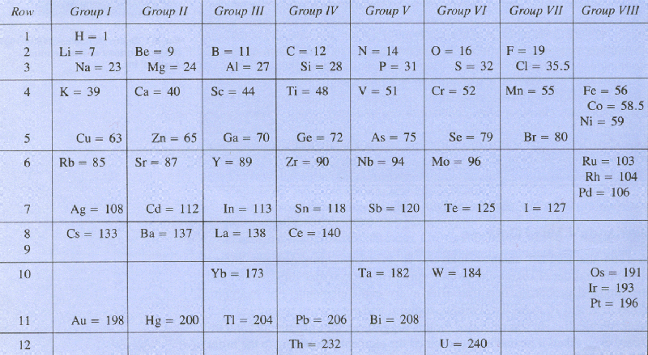
Mendeleev’s Periodic Chart
This was translated into English much later.

Slide 7
The Periodic Law
The Periodic Law states that elements arranged in order of increasing atomic number, show a pattern with their chemical and physical properties.

Slide 8
Organizing the Squares
There are 118 elements in the periodic table with more being discovered.
The shape of the table came from the periodic law to show elements with similar properties.

Slide 9
Organizing the Squares
The vertical columns are called groups (or families) all with the same properties; 18 in number
The horizontal rows are called periods (or series); seven in number

Slide 10
Organizing the Squares
A periodic square consists of 5 major details
The atomic number (top)
The element symbol (Letters in the center)
The Element name (directly under the symbol)
The Atomic Mass (directly under the element name)
And lastly the Electron Configuration (bottom center)

Slide 11
A Periodic Square

Slide 12
Labeling and Naming Groups
Family Names
Alkali Metals (Group 1A)
Alkaline Earth Metals (Group 2A)
Halogens (Group 8A)
Carbon Group (Group 4A)
Nobel Gases

Slide 13
Metals
Are characteristically silver, possess a very light luster and shine. They are good conductors of electricity and heat.
They are also very malleable and typically solids at room temperature.

Slide 14
Non Metals
These can be solids, liquids or gases. Very poor conductors of electricity and heat and

Slide 15
Semi-Metals
Often referred to as metalloids.
All of them are located touching the metalloid line which is toward the center-right of the chart.
There are 7 of them.
They have properties in between metals and non-metals.

Slide 16
Electron Configurations and the Periodic Table
Valence electrons are responsible the atoms chemical and reactive behavior.
Elements in a group have similar amounts of valence electrons as well as similar electron configurations.

Slide 17
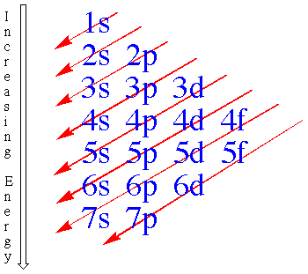
Electron Configuration Model
This is our guide – called the Diagonal Rule.

Slide 18
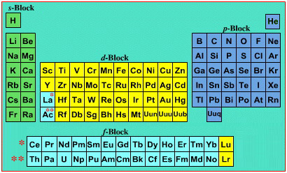
The s, p, d, and f Blocks

Slide 19
The s - sub block
The s-block consist of groups 1A and 2A (the Alkali and Alkaline Earth metals)
S-block elements have valence electrons in the s orbitals only which can only hold two electrons.

Slide 20
The p – sub block
The p-block consists of groups 3A through 8A.
The can all hold up to 6 electrons in 3 orbitals.

Slide 21
The s - Block Elements are in Red while The p - Block Elements are in Green

Slide 22
The d – sub block
The d-block consists of all the transition elements.
All transition elements can hold up to ten valence electrons on their outer shell.

Slide 23
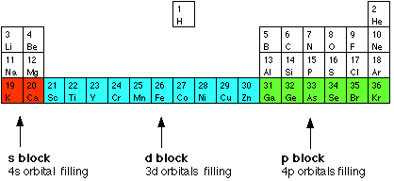
The d - block Elements
Showing their location on the chart. Note that only the top row is being shown here.

Slide 24
The f – sub block
The f-block consists of all the inner transition elements.
All inner transition elements can hold up to 14 electrons in their outer shell

Slide 25
The f - block Elements
Notice how this looks different from the chart you are used to. For a few years, the f-block was inserted in the chart this way.

Slide 26
Trends can be determined from the periodic chart.
The reason for the chart being the shape that it is, is due to arranging elements with similar properties in the same group.

Slide 27
Atomic Radius
Atomic Radius is the distance from the center of the nucleus to the outer most electron.
The principle quantum number increases as you move down a group.
The larger the quantum number larger the atomic radius.

Slide 28
Ionic Size
When an electron is lost the element becomes a positive ion called a cation.
When an element gains an electron it becomes a negative ion called an anion.

Slide 29
More properties of atoms
Ionization Energy is the amount of energy needed to remove an electron.
Electron Affinity is the energy charge when gaining an extra electron.

Slide 30
Electronegativity
Electronegativity is the ability to attract electrons in a chemical bond.
Fluorine is the most electronegative atom.

Slide 31
Periodic Trends
Many properties of the elements change in a predictable way as you move through the periodic table.
As you learn the trends, know how the patterns both from top to bottom of the chart and left to right.

Slide 32
Groups of elements have similar properties.
Therefore they can be studied together.

Slide 33
Alkali Metals
The term Alkali is used in the Arabic language to mean ashes
Most Alkali metals are known to be found in burnt plants.
The Alkali Metals are:
Lithium (Li), Sodium (Na), Potassium (K), Rubidium (Rb), Cesium (Cs) and lastly Francium (Fr).

Slide 34
Alkali Metals
Metals in this group resemble one another like a family.
They are shiny, malleable and ductile solids known for their good conductivity, low densities and low melting points.
These metals also can be cut by a knife and immediately begin to tarnish when hit by air.
These elements are also highly reactive due to their unique number of valence electrons.

Slide 35
Alkali Metals
Alkali Metals are never found in nature alone due to reactivity.
They are common in compounds such as Sodium found in table salt: NaCl
Often found paired with Group 7 elements.
They are also very soluble; Compounds containing an alkali metal make up about 3% of the worlds sea water.

Slide 36
Alkaline Earth Metals
The elements in group 2A are known as the Alkaline Earth Metals.
Beryllium (Be), Magnesium (Mg), Calcium (Ca), Strontium (Sr), Barium (Ba) and Radium (Ra).
The term came from middle age alchemists who thought of the elements as “substances unchanged by fire”.

Slide 37
Alkaline Earth Metals
Alkaline Earth Metals are known for their low melting points and low densities.
They all have a charge of +2 when they form ions.
Alkaline Earth Elements are mostly found in deposits and sea water.

Slide 38
Transition Elements
The elements located in the middle of the Periodic Table are called the Transition Elements (also the d-block elements).
They play an important role in living organisms such as Iron in hemoglobin in our blood.
Used in structural materials
Have very high densities and melting points

Slide 39
Important Transition Elements
Chromium
Often found in deposits in Russia, Southern Asia and the Phillipines.
Very resistant to corrosion
Very hard, silvery metal
Produces many alloys of stainless steel
Used in paint pigments.

Slide 40
Iron
Iron is a very inexpensive metal.
In the iron age, humans found ways to extract and use it from various ores.
An ore is a rock that contains a metal, so iron ore is a rock that contains iron.
When it corrodes it forms iron oxide also known as rust tu,rning it a red and brown color.

Slide 41
Coinage Metals
Coinage Metals are metals that were or still are used to make coins.
Silver, Copper and Gold
Often found in nature in the free state (not paired with another element).
These were among the first metals known to the early humans.

Slide 42
Coinage Metals
Bronze is an alloy of Tin and Copper.
It was used to make coins, weaponry, and some household tools starting in 5000 B.C
(the Bronze Age).
Bronze is very resistant to corrosion and is very abundant.
We still use bronze today. Many sculptures are cast in bronze.

Slide 43
Coinage Metals
Copper is a very soft metal unique with its distinctive red color and a good electrical conductor.
When alloyed with zinc it creates brass.
Copper is used in many everyday items like:
domestic water pipes and some cookware.
It has many uses.
Paint pigments, stained glass and fireworks

Slide 44
Coinage Metals
Silver is a highly lustrous, ductile, malleable and resistant to corrosion.
It is used in:
Jewelry
Silverware
Coinage
Photography

Slide 45
Coinage Metals
Gold is a very dense but soft metal. It is known for its bright yellow luster.
Just like silver it is also used in jewelry as:
Karats
White gold (gold and nickel)
Yellow Gold (gold and silver)
It is a great conductor of electricity and has been used as a currency for thousands of years.

Slide 46
Lanthanides
The Inner Transition Metals or d-block elements are classified into two groups:
The Lanthanides The Actinides
Characteristics: soft, silvery, reactive, easily tarnished, slow reactant with water, act together in nature and lastly are used as the color in television sets.
The lanthanides differ in the number of electrons in their outer sub levels.
They readily loose three electrons in order to form 3+ ions, which is its most common ion.
The Actinides are very radioactive artificial elements produced by nuclear bombardment, particularly uranium.

Slide 47
3A The Boron Group
The Boron Group consists of Boron, Aluminum, Gallium, Indium and Thallium.
Boron is classified as a semi-metal. The others are metals.
Aluminum is the 3rd most abundant element in the earth’s crust. And is 2nd in production and consumption behind iron.
It is found in common bauxite ore.
Charles Hall (from Cleveland) discovered an inexpensive way to extract the metal from the ore. Before this, aluminum was more expensive than gold.

Slide 48
4A The Carbon Group
The Carbon Group consists of elements: Carbon, Silicon, Germanium, Tin, and Lead
Carbon
All living things contain large molecules that are based on the element carbon.
Found in the fossil fuels coal, petroleum, and natural gas.
Produces hydrocarbons when combined with hydrogen
Silicon
The second most abundant element in Earth’s crust. Located in sand
Germanium, Tin, and Lead
Germanium is an important metalloid
Tin and Lead are found in many products

Slide 49
5A The Nitrogen Group
The Nitrogen group consists of elements: Nitrogen, Phosphorus, Arsenic, Antimony,
Bismuth
Nitrogen is a colorless, odorless gas that makes up 80 % of the earth’s atmosphere.
Used in ammonia and plant fertilizers
Phosphorus has a waxy feel to it and it will ignite in air. It can be very dangerous.
Bones in the human body are made of calcium and phosphorus
Phosphoric Acid is used in cola drinks to give it a sharp taste.

Slide 50
6A The Oxygen Group
The oxygen group consists of elements: Oxygen, Sulfur, Selenium, Tellurium, and Polonium
Oxygen; O₂ , is a colorless, odorless gas that makes up 21 % of our atmosphere and is the most common element in the earth’s crust.
Obviously has a crucial biological function.
Many industrial uses: Steel making, welding, chemical processes.
O₃ is an allotrope of oxygen called ozone and plays an important role in the upper atmosphere, protecting our planet.
Sulfur
Known as Brimstone and Fool’s Gold in the Old Days
Possesses a very distinctive smell.
One of the few elements found in the elemental state, esp. around volcanos.
Used in manufacturing as Sulfuric Acid which is the most important industrial chemical: Papermaking, steel production, etc.

Slide 51
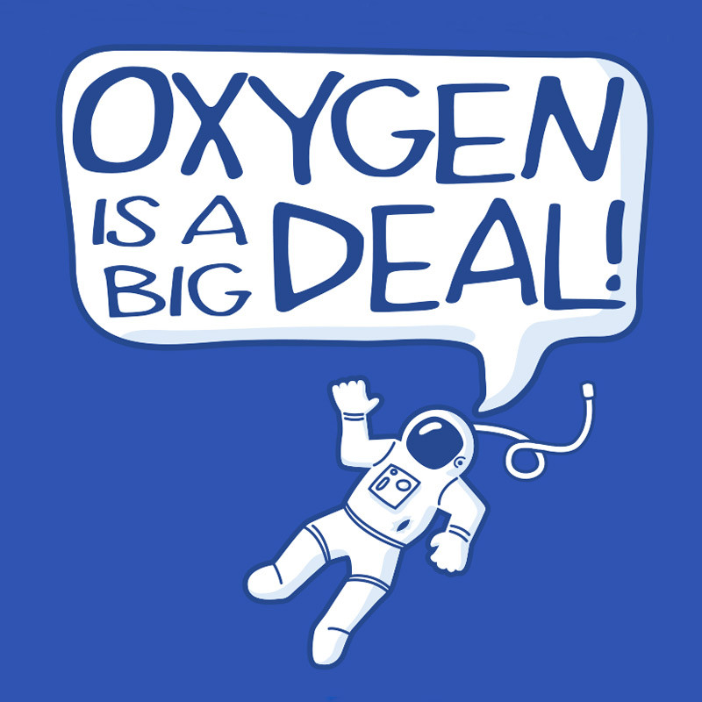
The Oxygen Group

Slide 52
7A The Halogens
All the Group 7 elements are non-metals:
Fluorine, Chlorine, Bromine, Iodine, and Astatine
Fluorine is the most reactive element of this group
Chlorine is a very important industrial element:
Purify drinking water and pools, bleach, salt, plastics
Bromine and Iodine
Least abundant of the group
Halogen headlights, photographic film
Iodine is needed by the body to help the thyroid function.

Slide 53
8A The Noble Gasses
The noble gases consist of the elements:
Helium, Neon, Argon, Krypton, Xenon, and Radon
They are characterized by having a filled outer shell naturally, so they do not need to combine with other elements to get a filled outer shell.
Some Noble gas compounds have been created in the lab.
The noble gases are the least reactive elements
These were among the last elements to be discovered.
Argon makes up 1% of Earth’s atmosphere.
Helium has the lowest boiling point
Neon signs are very common. Only the red ones actually have neon in them.

Slide 54
Hydrogen: One of a Kind
Most of Earth’s hydrogen combined with oxygen as water or combined with carbon and/or oxygen to form compounds.
Hydrogen is a non metal that:
Exists as a gas under normal conditions
Most abundant element in the universe by far.
Possesses one valence electron ( +1 charge)
Most acids have a Hydrogen ion in them.

