Slide 1
GASES

Slide 2
KINETIC MOLECULAR
THEORY OF GASES:
This theory is used to describe the nature
of gases and establish the gas laws.

Slide 3
KINETIC MOLECULAR
THEORY OF GASES:
Gases consist of small particles in rapid,
random motion.
2) There is very little attraction between
gas particles.
3) Average kinetic energy is proportional
to Kelvin temperature.
4) Gas particles are in constant, straight-line
motion.

Slide 4
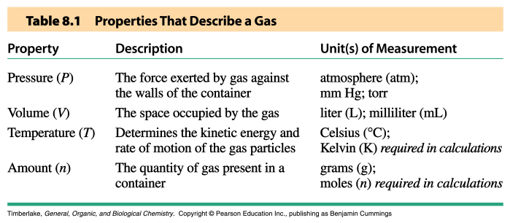

Slide 5
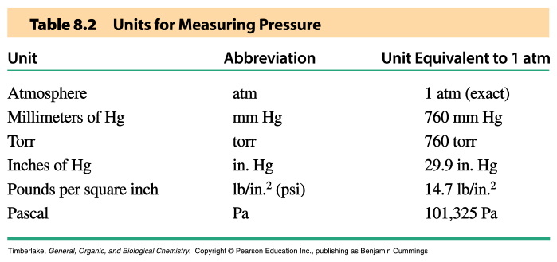
PRESSURE:
As gas particles hit the walls of their
container, they push on it. This force is
the pressure.
Pressure (P) = force/area

Slide 6
ATMOSPHERIC PRESSURE:
This is the pressure on the air around us.
Atmospheric pressure decreases as
elevation increases.
Atmospheric pressure is measured with a
BAROMETER, so it is often called barometric
pressure.
Don’t confuse ATMOSPHERIC PRESSURE
with the pressure unit ATMOSPHERE, which
is 760 mmHg.

Slide 7
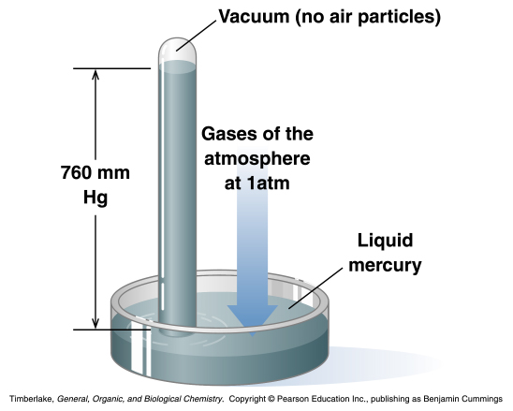

Slide 8
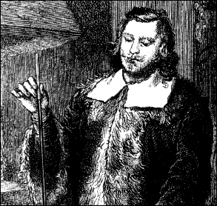
Evangelista Torricelli

Slide 9
BOYLE’S LAW:
Pressure and volume are inversely
proportional to each other. This means,
when pressure increases, volume decreases
and, when pressure decreases, volume
increases.
At constant n and T, PV = constant
or
P₁V₁ = P₂V₂.

Slide 10
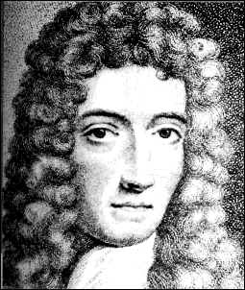
Robert Boyle
(It was common for men to wear wigs back then)

Slide 11
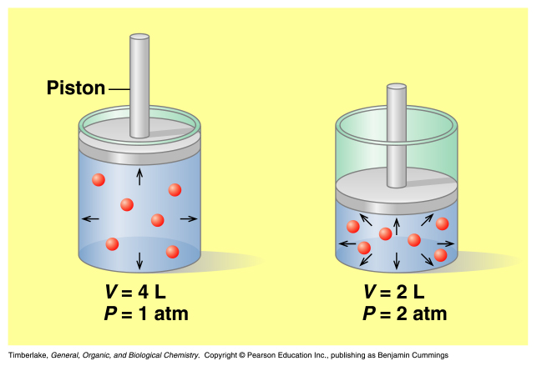
BOYLE’S LAW:
As volume gets smaller, the particles hit
the walls more often, raising the pressure.

Slide 12
BOYLE’S LAW:
A sample of helium has 4.0 L and 705
mm Hg. What is the volume of the sample
if the pressure is changed to 745 mm Hg?

Slide 13
CHARLES’ LAW:
Volume is directly proportional to
temperature. That is, when temperature
increases, volume increases and when
temperature decreases, volume decreases.
At constant n and P, V/T = constant
or
V₁/T₁ = V₂/T₂.

Slide 14
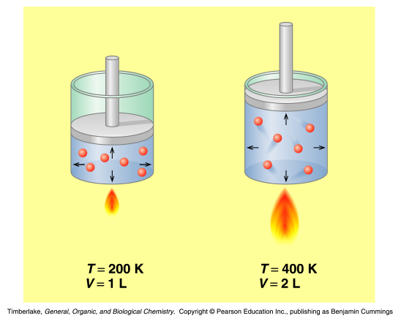
CHARLES’ LAW:
When temperature increases, gas particles
move faster. This means they hit the walls
of the container more often, causing it
to expand.

Slide 15
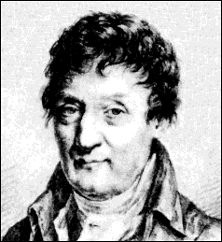
Jacque Charles
Invented the hydrogen-filled balloon and
on December 1, 1783, he ascended into the air
and became possibly the first man in history to
witness a double sunset.

Slide 16
CHARLES’ LAW
A balloon filled with air has a volume of
2.5 L. What is the volume of the balloon
if you bring it inside (25 °C) from the cold
weather (-5 °C)?
Remember, you MUST use Kelvin:
25 °C = 25 °C + 273 = 298 K
-5 °C = -5 °C + 273 = 268 K

Slide 17
GAY-LUSSAC’S LAW:
Pressure is directly proportional to Kelvin
temperature. That is, as temperature
increases, pressure increases and, as
temperature decreases, pressure decreases.
At constant n and V, P/T = constant
or
P₁/T₁ = P₂/T₂.

Slide 18
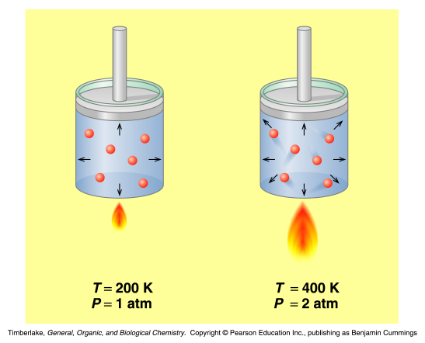
GAY-LUSSAC’S LAW:
As temperature increases, gas particles
move faster. This means that they hit the
walls of the container more often, increasing
the force applied to the walls.

Slide 19
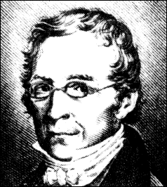
Joseph Louis Guy-Lussac
Actually discovered Charles’ Law, too.
Also a balloonist…on Sept. 16, 1804, rose to just over
23,000 feet (about 4.3 miles), a world altitude record for
over 50 years.

Slide 20
Why should you
study chemistry?
The same year a 23-year-old Gay-Lussac discovered this
law, he had occasion to walk into a linen draper's shop in
Paris and there he made a wonderous discovery. He found
the 17-year-old shopgirl reading a chemistry textbook while
waiting for customers. Needless to say, he was intrigued by
this and made more visits to the shop. In 1808, he and
Josephine were married and over the years, five little
Gay-Lussacs were added to the scene.

Slide 21
GAY-LUSSAC’S LAW:
You fill your car tires to 35 psi in the
summer when it’s 31 °C. At Thanksgiving,
when it’s -7 °C, you notice that your tire is
low. Why?
Remember, you MUST use Kelvin:
31 °C = 31 °C + 273 = 304 K
-7 °C = -7 °C + 273 = 266 K

Slide 22
VAPOR PRESSURE
AND BOILING POINT:
The pressure of the vapor above a liquid
is called the VAPOR PRESSURE.
When the vapor pressure equals the
external (atmospheric) pressure, that is
the BOILING POINT.

Slide 23
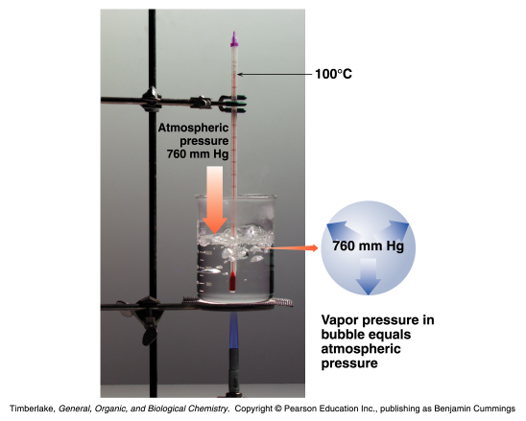

Slide 24
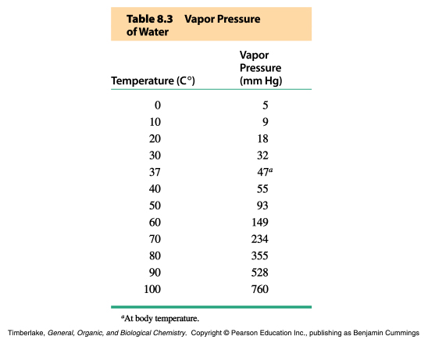
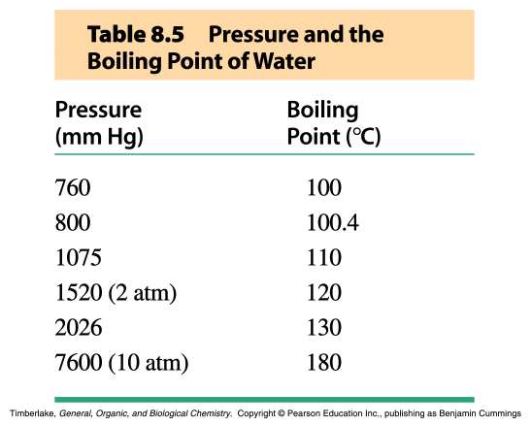

Slide 25
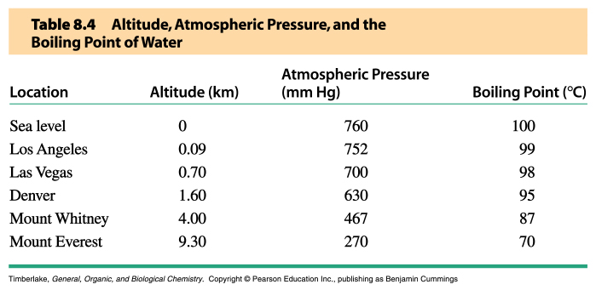
VAPOR PRESSURE
AND BOILING POINT:
As elevation increases, pressure decreases.
This is why water boils at lower temperatures
at high altitudes.

Slide 26
COMBINED GAS LAW:
We can take all of the pressure-volume-
temperature relationships we’ve just
talked about and combine them into
one gas law:
(P₁V₁)/T₁ = (P₂V₂)/T₂
If you remember this gas law, you can
figure out the others.

Slide 27
COMBINED GAS LAW:
A scuba diver 40 ft below the ocean surface
inhales 50.0 mL of compressed air in a scuba
tank at a pressure of 3.00 atm and a
temperature of 8 °C. What is the pressure
of air in the lungs if the gas expands to
150.0 mL at a body temperature of 37 °C?
Remember, you MUST use Kelvin:
8 °C = 8 °C + 273 = 281 K
37 °C = 37 °C + 273 = 310 K

Slide 28
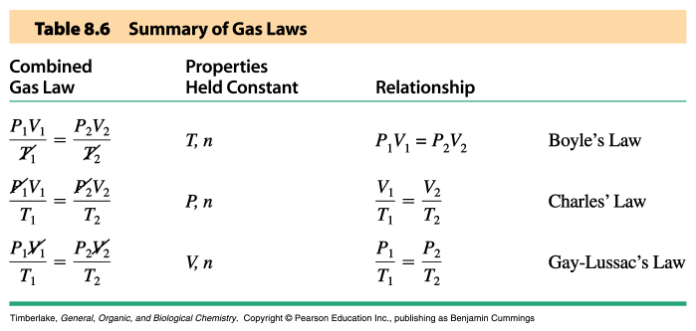

Slide 29
AVOGADRO’S LAW:
In each of the previous gas laws, we’ve
assumed that the amount (grams or moles)
of gas doesn’t change.
Gas amount and volume are directly
proportional to each other. This means,
when you have more gas, volume increases
and, when you have less gas, volume
decreases.
V₁/n₁ = V₂/n₂

Slide 30
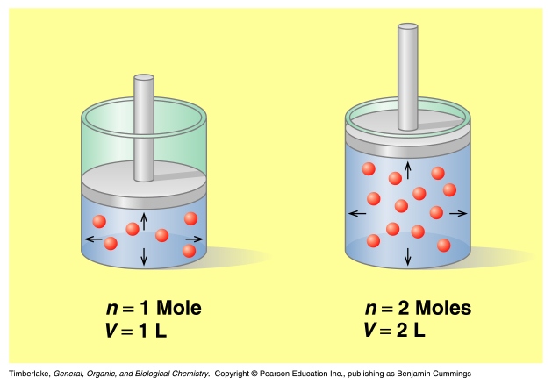
AVOGADRO’S LAW:
The more gas particles there are, the more
will hit the walls of the container, causing
it to expand.

Slide 31
STP AND MOLAR VOLUME:
Avogadro’s law tells us that two gases at
the same temperature and pressure will
have the same volume.
STANDARD TEMPERATURE AND
PRESSURE (STP) is often used when
comparing gases.
STANDARD TEMPERATURE = 0 °C (273 K)
STANDARD PRESSURE is 1 atm (760 mm Hg)

Slide 32
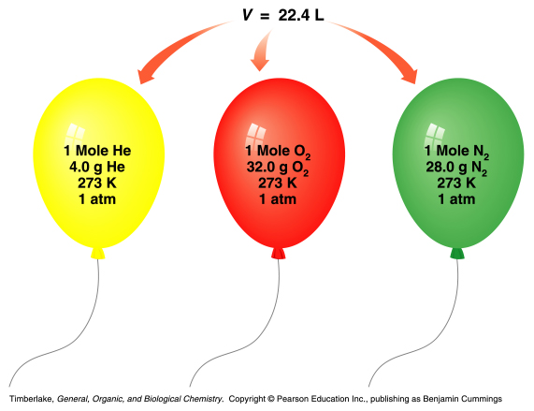
STP AND MOLAR VOLUME:
At STP, the volume of one mole of ANY gas
is 22.4 L.
Conversion
Factors:
1 mol @STP
22.4 L
or
___22.4 L___
1 mol @ STP

Slide 33
IDEAL GAS LAW:
When dealing with a single gas, but no
changes in conditions, we can describe
the gas with the IDEAL GAS LAW:
PV = nRT.
R is a constant, 0.0821 L x atm/mole x K.

Slide 34
IDEAL GAS LAW:
You fill your bike tire with 3.0 L of air at
7.15 atm on a summer day that is 30 °C.
How many moles of air are in your bike
tire?
Remember, you MUST use Kelvin:
30 °C = 30 °C + 273 = 303 K

Slide 35
REMEMBER THIS:
Moles A → Moles B
Grams of A Grams of B
x g/mole of B
x mole/g of A

Slide 36
Moles A → Moles B
Grams of A Grams of B
x mole/g of A
x g/mole of B
n = PV/RT
PV = nRT
Gas P, V, or T of B

Slide 37
Problem 8.98 on Page 275:
Hydrogen gas can be produced in the laboratory though the reaction of magnesium metal with hydrochloric acid:
Mg (s) + 2 HCl → MgCl₂ (aq) + H₂ (g)
What is the volume, in liters, of H₂ gas produced at 24 °C and 835 mm Hg, from the reaction of 12.0 g of Mg?

Slide 38
DALTON’S LAW:
The pressure of a mixture of gases is equal
to the sum of the pressure of each of the
gases.
The total pressure of a gas mixture depends
on the total number of gas particles, not on
the types of particles.
The pressure of each gas is equal to the
total pressure times the (molar) percent
of the gas in the mixture.
P_{tot} = P₁ + P₂ + P₃ + …

Slide 39
TOTALPRESSURE:
For example, at STP, one mole of gas particles in a volume of 22.4 L will exert the same pressure as one mole of a mixture of gas particles in 22.4 L.
1.0 mole N₂
0.4 mole O₂
0.6 mole He
1.0 mole
0.5 mole O₂
0.3 mole He
0.2 mole Ar
1.0 mole
1.0 atm
1.0 atm
1.0 atm

Slide 40
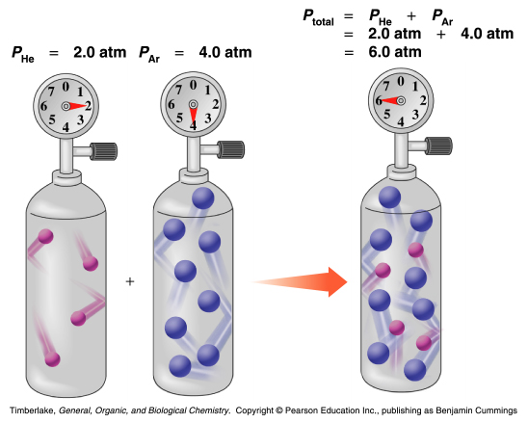

Slide 41
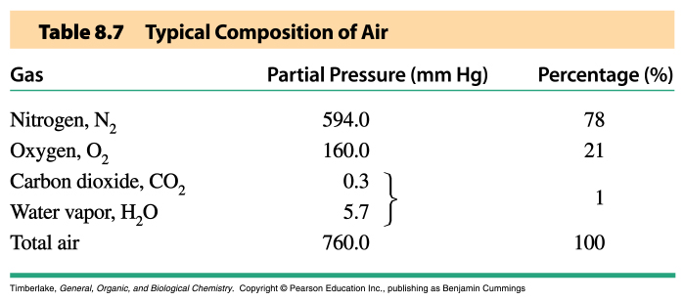

Slide 42
DALTON’S LAW:
During space walks, astronauts breathe
a mixture of nitrogen and oxygen that has
a total pressure of 7.0 atm. The partial
pressure of nitrogen in this mixture is
5.6 atm. What is the partial pressure of
oxygen? What is the composition of this
mixture?

Slide 43
DALTON’S LAW:
Dalton’s Law is especially important for
breathing. Not only for things like scuba
tanks, but especially in medical situations.
This is why “blood gases” are often
measured.

Slide 44
When the lungs expand, the pressure in the lungs decreases.
Inhalation occurs as air flows towards the lower pressure in the lungs.

Slide 45
When the lung volume decreases, pressure within the lungs increases.
Exhalation occurs as air flows from the higher pressure in the lungs to the outside.

Slide 46
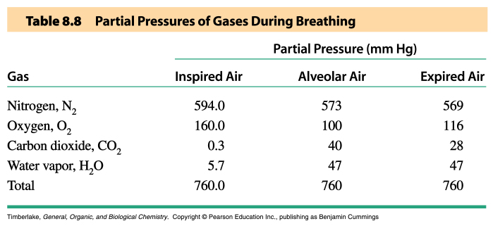
(c) Douglas E. Raynie, South Dakota State University, 2004

Slide 47
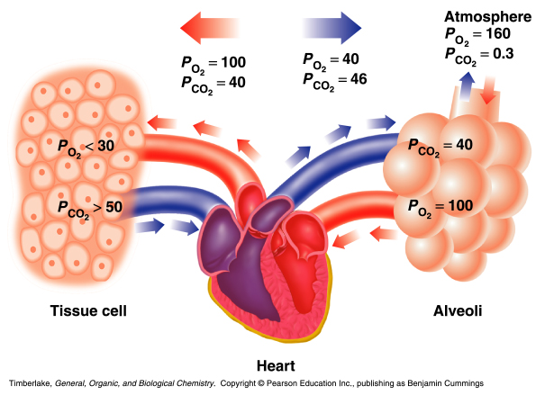
(c) Douglas E. Raynie, South Dakota State University, 2004

